Slide 1




PRESENTED BY :
GANGISETTI L V S S SUBRAHMANYAM -322506402110 GRANDHI SUJAINA - 322506402128
GANDI CHANDRA SEKHAR - 322506402107
KARRA KANAKA KALPAVALLI SRAVANI - 322506402169 AKHILA KUMARI BANDI - 322107311058

Slide 2



CONTENTS
Abstract
Introduction
System Requirements Architecture
Uses of data analysis library Advantages
Conclusion

Slide 3


ABSTRACT
THIS STUDY PRESENTS A COMPREHENSIVE ANALYSIS OF
WALMART'S E-COMMERCE SALES DATA USING PYTHON’S ROBUST DATA HANDLING LIBRARY, PANDAS, AND INSIGHTFUL
DATA VISUALIZATION TOOLS SUCH AS MATPLOTLIB AND SEABORN.
THE DATASET EMPLOYED IN THIS ANALYSIS CONTAINS DETAILED
TRANSACTION RECORDS FROM WALMART'S ONLINE RETAIL OPERATIONS. IT INCLUDES MULTIPLE VARIABLES SUCH AS ORDER DATES, PRODUCT CATEGORIES, REGIONAL SALES PERFORMANCE, CUSTOMER SEGMENTS, AND PROMOTIONAL DISCOUNTS. THE PRIMARY GOAL OF THIS ANALYSIS
IS TO UNCOVER TRENDS, SEASONAL PATTERNS, AND KEY FACTORS INFLUENCING SALES PERFORMANCE AND CUSTOMER PURCHASING
BEHAVIOUR.

Slide 4

INTRODUCTION
IN THE ERA OF DIGITAL TRANSFORMATION, E-COMMERCE HAS EMERGED AS A CRITICAL DRIVER
OF RETAIL SUCCESS. AMONG LEADING GLOBAL RETAILERS, WALMART HAS SUCCESSFULLY EXPANDED
ITS TRADITIONAL BRICK-AND-MORTAR BUSINESS INTO THE ONLINE DOMAIN, SERVING MILLIONS OF CUSTOMERS THROUGH ITS E-COMMERCE PLATFORMS. THIS PROJECT, “E-COMMERCE WALMART SALES ANALYSIS,” FOCUSES
ON ANALYZING HISTORICAL SALES DATA FROM WALMART'S ONLINE STORES TO UNCOVER KEY TRENDS, PERFORMANCE PATTERNS, AND ACTIONABLE BUSINESS INSIGHTS.
THE PRIMARY OBJECTIVE OF THIS PROJECT IS TO EXPLORE HOW VARIOUS FACTORS—SUCH AS STORE TYPE, LOCATION,
SEASONAL EVENTS (LIKE HOLIDAYS), AND PROMOTIONAL STRATEGIES—IMPACT SALES PERFORMANCE ACROSS WALMART’S E-COMMERCE CHANNELS. THROUGH DATA VISUALIZATION AND STATISTICAL ANALYSIS, THE PROJECT
AIMS TO IDENTIFY OPPORTUNITIES FOR IMPROVING SALES FORECASTING, INVENTORY PLANNING, AND CUSTOMER TARGETING.
BY LEVERAGING TOOLS SUCH AS PYTHON, PANDAS, MATPLOTLIB, AND MACHINE LEARNING TECHNIQUES,
THIS ANALYSIS PROVIDES A COMPREHENSIVE OVERVIEW OF WALMART'S E-COMMERCE PERFORMANCE.
IT SUPPORTS DATA-DRIVEN DECISION-MAKING AND OFFERS RECOMMENDATIONS TO ENHANCE OPERATIONAL EFFICIENCY AND BOOST REVENUE IN A HIGHLY COMPETITIVE ONLINE RETAIL ENVIRONMENT.

Slide 5
SYSTEM REQUIREMENTS
SOFTWARE REQUIREMENT :
OPERATING SYSTEM:
THE ANALYSIS CAN BE PERFORMED ON WINDOWS .
PYTHON: PYTHON 3.X IS REQUIRED FOR RUNNING THE ANALYSIS.
LIBRARIES:
PANDAS: INSTALL THE PANDAS LIBRARY USING PIP, A PACKAGE MANAGER FOR PYTHON. PIP INSTALL PANDAS
MATPLOTLIB: INSTALL THE MATPLOTLIB LIBRARY USING PIP AS WELL PIP INSTALL MATPLOTLIB
SEABORN: INSTALL THE SEABORN LIBRARY USING PIP COMMAND PIP INSTALL SEABORN
HARDWARE REQUIREMNTS :
IDE – JUPYTER NOTEBOOK
STORAGE SPACE – FREE STORAGE SPACE ENOUGH FOR RUNNING ON MACHINE

Slide 6




THE ARCHITECTURE OF THE E-COMMERCE [WALMART] SALES ANALYSIS USING PYTHON, MATPLOTLIB,
AND PANDAS INVOLVES SEVERAL KEY STEPS THAT FORM A COHESIVE WORKFLOW..
THIS ARCHITECTURE HELPS YOU PROCESS, STORE, AND ANALYZE LARGE VOLUMES OF SALES DATA EFFECTIVELY:
IN CODING ARCHITECTURE WE HAVE DONE THE FOLLOWING STEPS: 1.IMPORTING DATASET 5.GROUPING
2.APPLYING BASIC FUNCTIONS 6. SORTING
3 .DATA CLEANING 7. AGGREGATE QUERIES
4.DATA FILTERING 8. VISUALIZATION

Slide 7
IMPORTING DATASET
THE PROJECT BEGINS WITH DATA COLLECTION, WHERE THE WALMART E-COMMERCE
SALES DATASET IS SOURCED FROM RELIABLE REPOSITORIES SUCH AS KAGGLE, UCI MACHINE LEARNING REPOSITORY, OR COMPANY-SPECIFIC DATABASES.
THE DATASET IS THEN LOADED INTO THE PYTHON ENVIRONMENT USING THE PANDAS LIBRARY, WHICH CREATES A STRUCTURED DATAFRAME TO FACILITATE EFFICIENT DATA HANDLING AND PREPROCESSING FOR FURTHER ANALYSIS.
PYTHON CODE TO DEMONSTRATE TO TYPICALLY LOAD AND INSPECT THE WALMART E-COMMERCE DATASET USING PANDAS:
import pandas as pd
import matplotlib.pyplot as plt import seaborn as sns #
df = pd.read_csv("C: \Users \Pandu \Downloads \Walmart.csv")
df

Slide 8

DATA CLEANING IS PERFORMED TO HANDLE MISSING VALUES, DUPLICATES, AND IRRELEVANT COLUMNS, ENSURING THE DATASET IS READY FOR ANALYSIS. ANY INCONSISTENCIES OR DATA QUALITY ISSUES ARE ADDRESSED DURING THIS STAGE.
## Data Cleaning
df['Date'] = pd.to_datetime(df['Date'])
# 2. Fi l missing numerical columns with median
num_cols = ['Weekly_Sales', 'Temperature', 'Fuel_Price', 'CPI', 'Unemployment'] # Check if the column has any missing values
if df[col].isnu l().sum() > 0:
# Replace missing values with the median of that column to maintain data distribution df[col].fi lna(df[col].median(), inplace=True)
# 3. Drop duplicates
# Remove any duplicate rows from the dataframe to prevent bias in analysis df.drop_duplicates(inplace=True)

Slide 9
DATA FILTERING
DATA FILTERING IS THE PROCESS OF SELECTING A SUBSET OF DATA FROM A LARGER DATASET BASED ON SPECIFIC CONDITIONS OR CRITERIA.
PURPOSE OF DATA FILTERING IS :
TO FOCUS ON RELEVANT INFORMATION TO REMOVE NOISE OR IRRELEVANT DATA TO PERFORM TARGETED ANALYSIS
# Filtering Data
# 1. Filter data for holidays only
# 2. Filter stores with sales above $1 mi lion
# Create a subset of the dataframe containing only rows where
# Create a new DataFrame containing only rows where Weekly_Sales exceed
Holiday_Flag equals 1
$1,000,000
# This isolates sales data that occurred during holidays for further
high_sales = df[df['Weekly_Sales'] > 1_000_000]
analysis
# Display the first 5 rows of the filtered DataFrame to inspect high-performing
holiday_sales = df[df['Holiday_Flag'] == 1]
stores
print(holiday_sales.head()) # Display the first 5 rows of the holiday sales
print(high_sales.head())
data

Slide 10
DATA GROUPING
GROUPINGS AND FILTERING OPERATIONS ARE UTILIZED TO IDENTIFY PATTERNS AND CORRELATIONS
WITHIN THE DATASET. THIS PHASE AIMS TO UNDERSTAND HOTEL VISITING CUSTOMER TYPES DISTRIBUTION, MEAL VARIATIONS, AND OTHER RELEVANT CHARACTERISTICS
# Grouping
#1. Average weekly sales per store
# Group data by 'Store' column and calculate the mean of 'Weekly_Sales' for each store # This gives us the average weekly sales performance for each individual store avg_sales_per_store = df.groupby('Store')['Weekly_Sales'].mean()
# Display the results showing each store and its corresponding average weekly sales print(avg_sales_per_store)

Slide 11
DATA SORTING
DATA SORTING IS THE PROCESS OF ARRANGING DATA IN A SPECIFIC ORDER BASED ON
ONE OR MORE COLUMNS . IT CAN BE IN ASCENDING OR DESCENDING ORDER.
SORTING IS IMPORTANT BECAUSE :
TO EASILY IDENTIFY TOP OR BOTTOM VALUES (E.G., HIGHEST SALES) TO ORGANIZE DATA FOR REPORTS OR VISUALIZATIONS
TO PERFORM RANKING OR COMPARISON
#Sorting
# 1. Sort by highest sales
# This sorts the dataset in descending order based on 'Weekly_Sales' to find the highest sales. # It helps identify top-performing records with maximum sales.
sorted_sales = df.sort_values(by='Weekly_Sales', ascending=False) print(sorted_sales.head())

Slide 12
AGGREGATE QUERIES
IN PYTHON, AGGREGATE QUERIES ARE TYPICALLY PERFORMED USING THE PANDAS LIBRARY, WHICH PROVIDES POWERFUL FUNCTIONS SIMILAR TO SQL AGGREGATE FUNCTIONS.
# AGGREGATED STATS
# THIS BLOCK CALCULATES AGGREGATED STATISTICS LIKE MIN, MAX, MEAN, MODE, AND VARIANCE OF 'WEEKLY_SALES'. # IT PROVIDES A QUICK SUMMARY OF THE SALES DISTRIBUTION FOR DEEPER INSIGHTS.
agg_stats = {
'min': df['Weekly_Sales'].min(),
'max': df['Weekly_Sales'].max(),
'mean': df['Weekly_Sales'].mean(),
'mode': df['Weekly_Sales'].mode()[0], 'variance': df['Weekly_Sales'].var()
}
print(agg_stats)

Slide 13
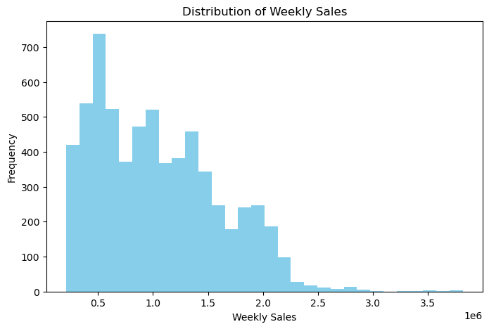
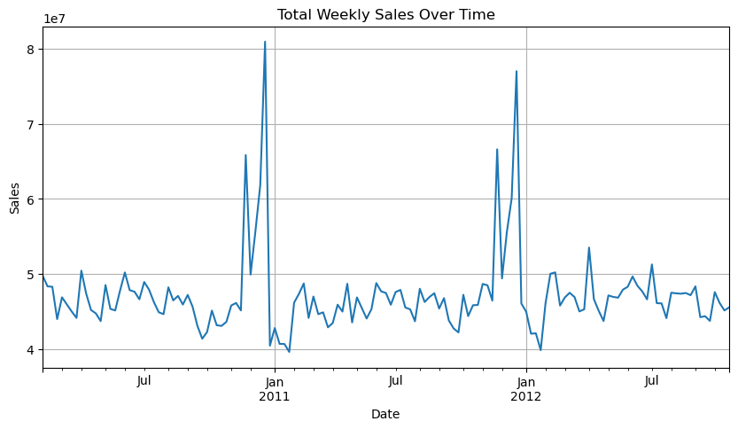
DATA VISUALIZATION
DATA VISUALIZATION IS THE GRAPHICAL REPRESENTATION OF INFORMATION AND DATA USING VISUAL ELEMENTS LIKE CHARTS, GRAPHS, MAPS, AND PLOTS.
IT HELPS IN UNDERSTANDING TRENDS, PATTERNS, AND OUTLIERS IN DATA BY MAKING COMPLEX DATA MORE ACCESSIBLE, UNDERSTANDABLE, AND USABLE.

Slide 14
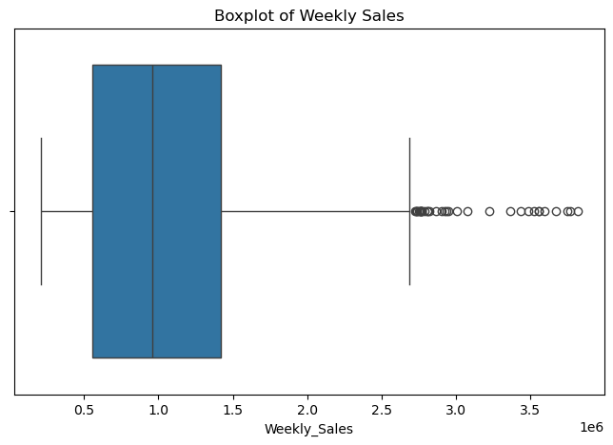
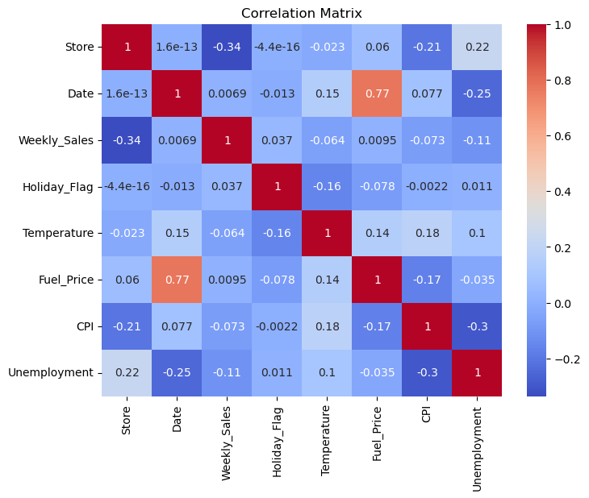
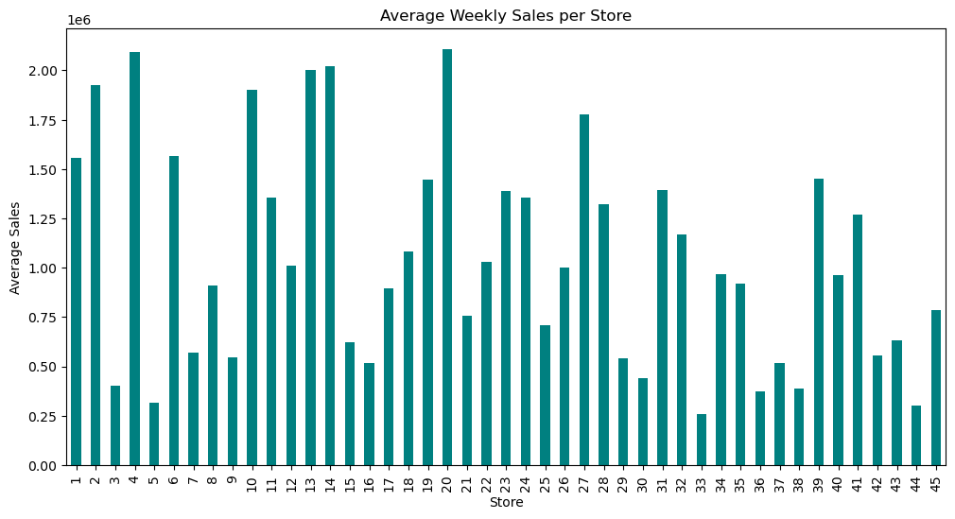
DATA VISUALIZATION

Slide 15

USES OF DATA ANALYSIS LIBRARY
PANDAS
Data Manipulation:. It allows filtering, grouping, and aggregating data to derive meaningful insights.
MATPLOTLIB
SEABORN
Data Visualization: Matplotlib allows the
Enhanced Data Visualization: Seaborn is
creation of various visualizations like line
built on top of Matplotlib and offers
plots, bar charts, and scatter plots to depict
Handling Missing Data: Pandas' functions booking trends, revenue fluctuations, and handle missing data points effectively,
customer distribution.
ensuring data quality and preventing
biases in the analysis.
Time Series Analysis: With Matplotlib,
more aesthetically pleasing and informative
visualizations. it simplifies the creation
of complex plot like heatmaps, pair plots,
and violin plots.
Categorical Data Visualization: It excels at
Joining and Merging: Pandas is used to
combine datasets when additional information, such as customer reviews or
hotel amenities, is available separately.
visualizing categorical data, such as room
time series plots can illustrate booking
types or customer nationalities, using bar
patterns over specific time intervals,
plots or box plots,which aids in
highlighting seasonal variations and trends.
understanding preferences and trends.

Slide 16
ADVANTAGES
1.VERSATILITY AND FLEXIBILITY:
MULTI-CATEGORY SUPPORT: THE SYSTEM CAN HANDLE DIVERSE PRODUCT CATEGORIES LIKE ELECTRONICS, CLOTHING, GROCERIES, ETC., MAKING IT ADAPTABLE TO WALMART'S WIDE PRODUCT RANGE.
CUSTOMIZABLE FILTERS AND REPORTS: USERS CAN FILTER DATA BY TIME PERIOD, PRODUCT TYPE, STORE LOCATION, ETC., ALLOWING FOR TARGETED INSIGHTS.
2.RICH DATA ANALYSIS LIBRARIES:
PANDAS, MATPLOTLIB, AND SEABORN PROVIDE A COMPREHENSIVE SUITE OF DATA MANIPULATION,
VISUALIZATION, AND STATISTICAL FUNCTIONS. THEIR EXTENSIVE CAPABILITIES EMPOWER ANALYSTS TO PERFORM COMPLEX DATA ANALYSIS AND GENERATE INFORMATIVE VISUALIZATIONS WITH RELATIVE EASE.

Slide 17
ADVANTAGES
3.DATA VISUALIZATION:
MATPLOTLIB AND SEABORN EXCEL AT CREATING VISUALLY APPEALING AND INFORMATIVE
PLOTS, CHARTS, AND GRAPHS. THESE VISUALIZATIONS ENHANCE THE PRESENTATION OF COMPLEX DATA, MAKING IT EASIER FOR STAKEHOLDERS TO UNDERSTAND TRENDS, PATTERNS, AND CORRELATIONS.
4.DATA-DRIVEN DECISION MAKING:
BY ANALYZING BOOKING PATTERNS, CUSTOMER PREFERENCES, AND REVENUE
TRENDS, HOTEL MANAGEMENT CAN MAKE DATA-DRIVEN DECISIONS TO OPTIMIZE PRICING, MARKETING STRATEGIES, AND OPERATIONAL EFFICIENCY. THIS LEADS TO BETTER RESOURCE ALLOCATION AND IMPROVED CUSTOMER EXPERIENCES.

Slide 18


THE WALMART E-COMMERCE SALES ANALYSIS PROJECT PROVIDED VALUABLE INSIGHTS INTO
CUSTOMER PURCHASING PATTERNS, PRODUCT PERFORMANCE, AND SALES TRENDS ACROSS DIFFERENT REGIONS AND TIME PERIODS. BY LEVERAGING DATA ANALYSIS TECHNIQUES
USING PYTHON AND LIBRARIES LIKE PANDAS, MATPLOTLIB, AND SEABORN, WE WERE ABLE TO:
IDENTIFY PEAK SALES PERIODS AND HIGH-PERFORMING PRODUCT CATEGORIES. UNDERSTAND REGIONAL SALES DISTRIBUTION AND STORE-WISE PERFORMANCE. ANALYZE THE IMPACT OF HOLIDAYS, WEEKDAYS, AND SEASONS ON OVERALL SALES.
THIS PROJECT DEMONSTRATES THE POWER OF DATA-DRIVEN DECISION-MAKING IN THE RETAIL INDUSTRY. BY CONTINUOUSLY ANALYZING SALES DATA, WALMART AND SIMILAR BUSINESSES CAN ENHANCE CUSTOMER EXPERIENCE, BOOST OPERATIONAL EFFICIENCY, AND DRIVE REVENUE GROWTH.

Slide 19
THANK YOU!

